Slide 1
Progressive Education Society's Modern College of Engineering MCA Department Quiz Game
(Android App)
FYMCA-Sem-II(Term-I)
Group 3
Ghanshyam Zurange - 51067
Naresh Choudhary - 51008
Akash Pardeshi - 51043
Vivek Para - 51041
Project Guide : Dr. Shivani Budhkar
Academic Year- 2020-21 (Term-I)

Slide 2
Contents
Project Introduction
Need of the system
Scope of the system
Requirement of the system
Firestore Database
Flow chart
Use case Diagrams
Data Dictionary
Screen layouts
Reports
Limitations & future Enhancements
MCOE FYMCA-21 QuizGame

Slide 3
Project Introduction
Quiz Game is a realtime Android Application. Developed for multiple users from different domains to challenge their knowledge.
This application provides a facility to play online quiz.
It provides a good platform, where a user not only improves their knowledge/skill but also they can have fun at the same time.
Project Audience:
Wide categories of audience can use the app. School and college students can gain knowledge while having fun.
MCOE FYMCA-21 QuizGame

Slide 4
Need of the system
Due to the current pandemic situation, all the major exams are conducted in MCQ format.
Students can get familiar with the MCQ format by using QuizGame.
Users can earn money by using Quiz Game.
MCOE FYMCA-21 QuizGame

Slide 5
Scope of the system
The scope of this project is very broad in terms of gaining and sharing knowledge across the world.
Few important points:
Can be used anywhere, anytime as it is a mobile application.
This app can be used in educational institutes as well as in corporate world.
It is a flexible app, with wide range of categories of Quiz.
MCOE FYMCA-21 QuizGame

Slide 6
Requirement of the system
Specifications :
H/W Specifications:
8 GB RAM
i5 processor 8th generation
S/W Specifications:
Windows 10
Android Studio 4.2.2
Database tool- No SQL(Firebase)
MCOE FYMCA-21 QuizGame

Slide 7
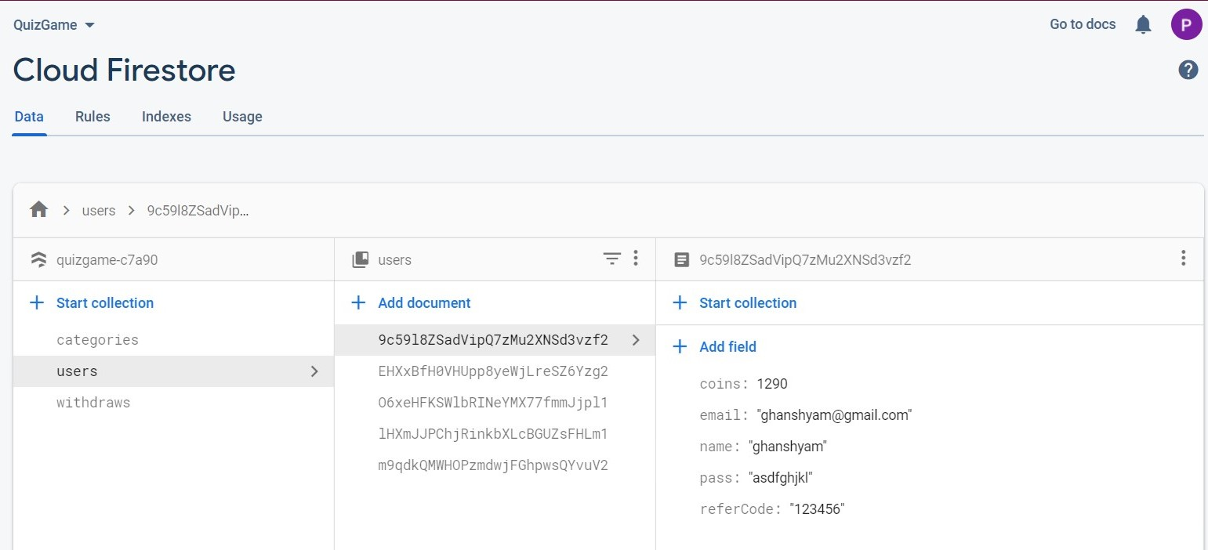
Firestore Database
Users :
MCOE FYMCA-21 QuizGame

Slide 8
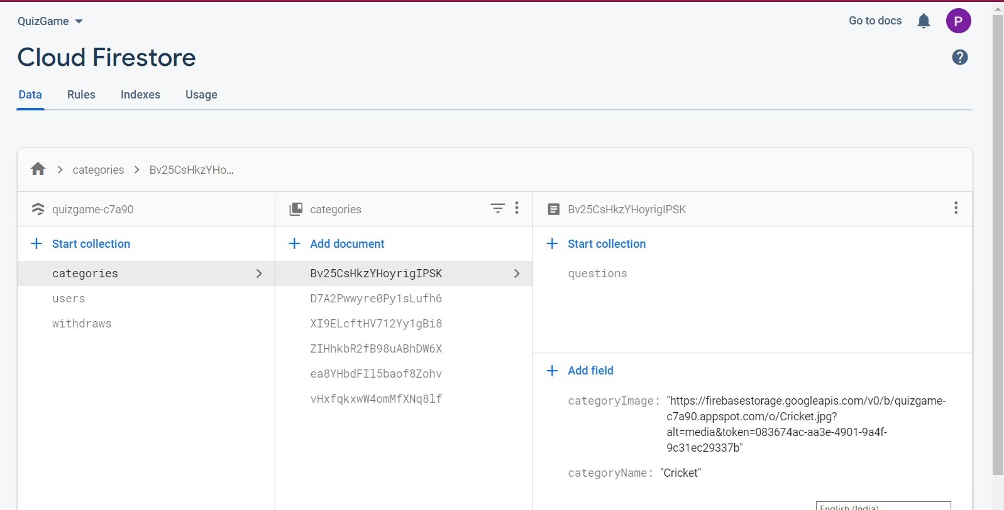
Firestore Database
Categories :
MCOE FYMCA-21 QuizGame

Slide 9
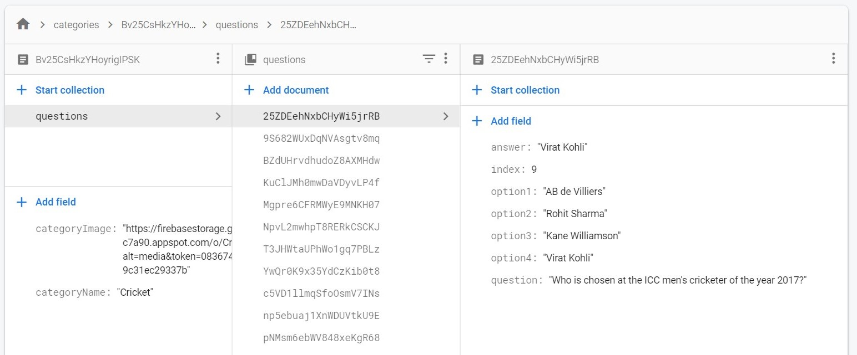
Firestore Database
Questions :
MCOE FYMCA-21 QuizGame

Slide 10
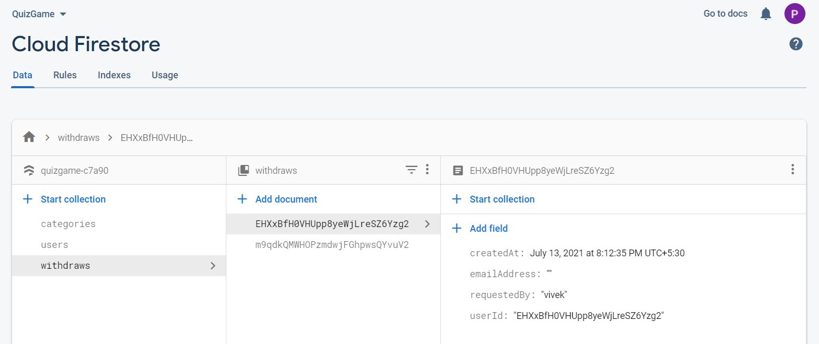
Firestore Database
Withdraws :
MCOE FYMCA-21 QuizGame

Slide 11
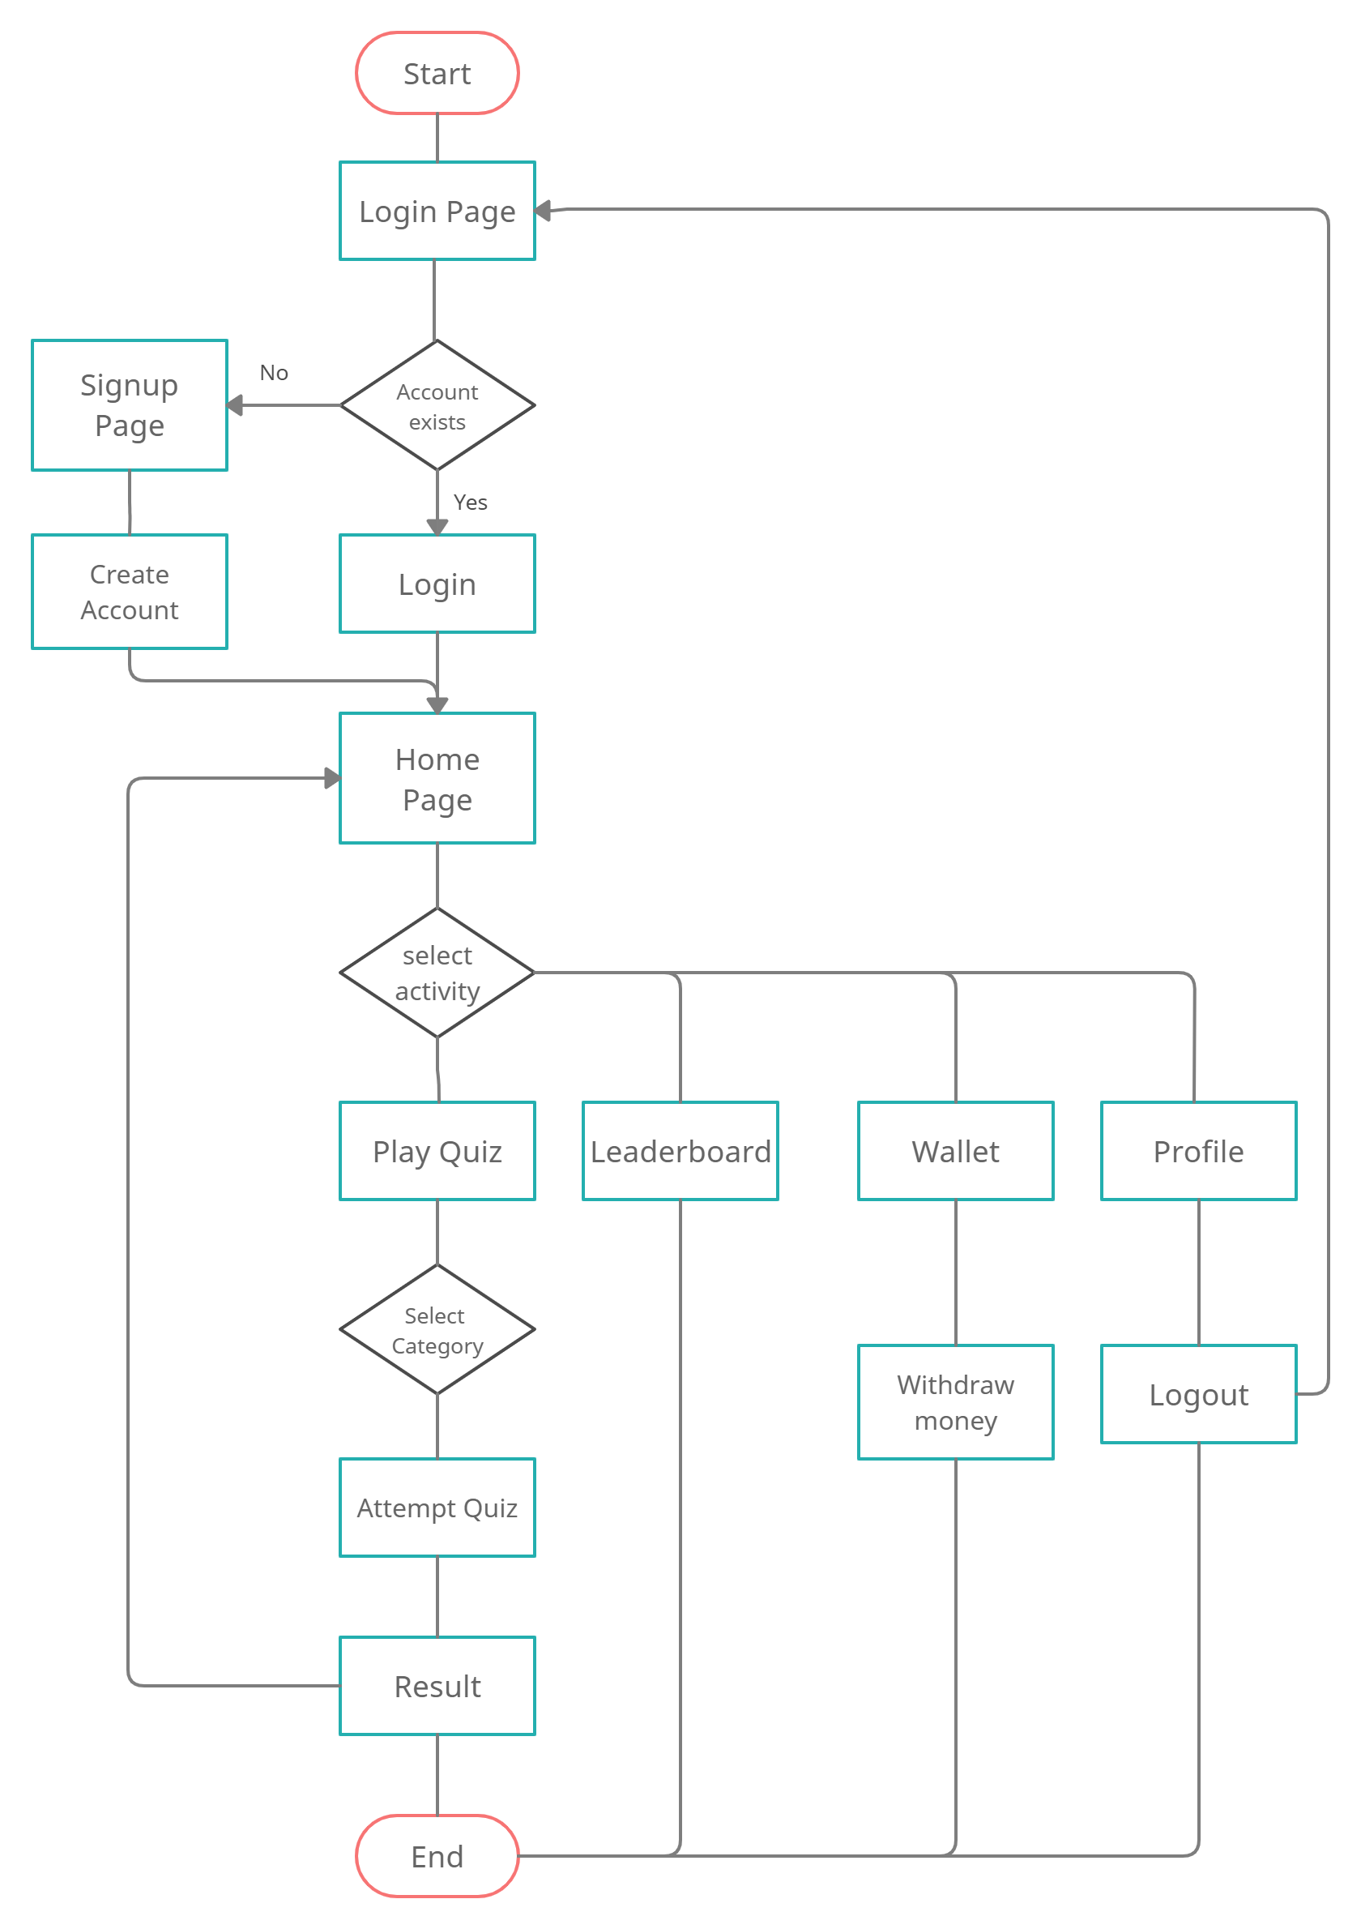
Flow chart
MCOE FYMCA-21 QuizGame

Slide 12
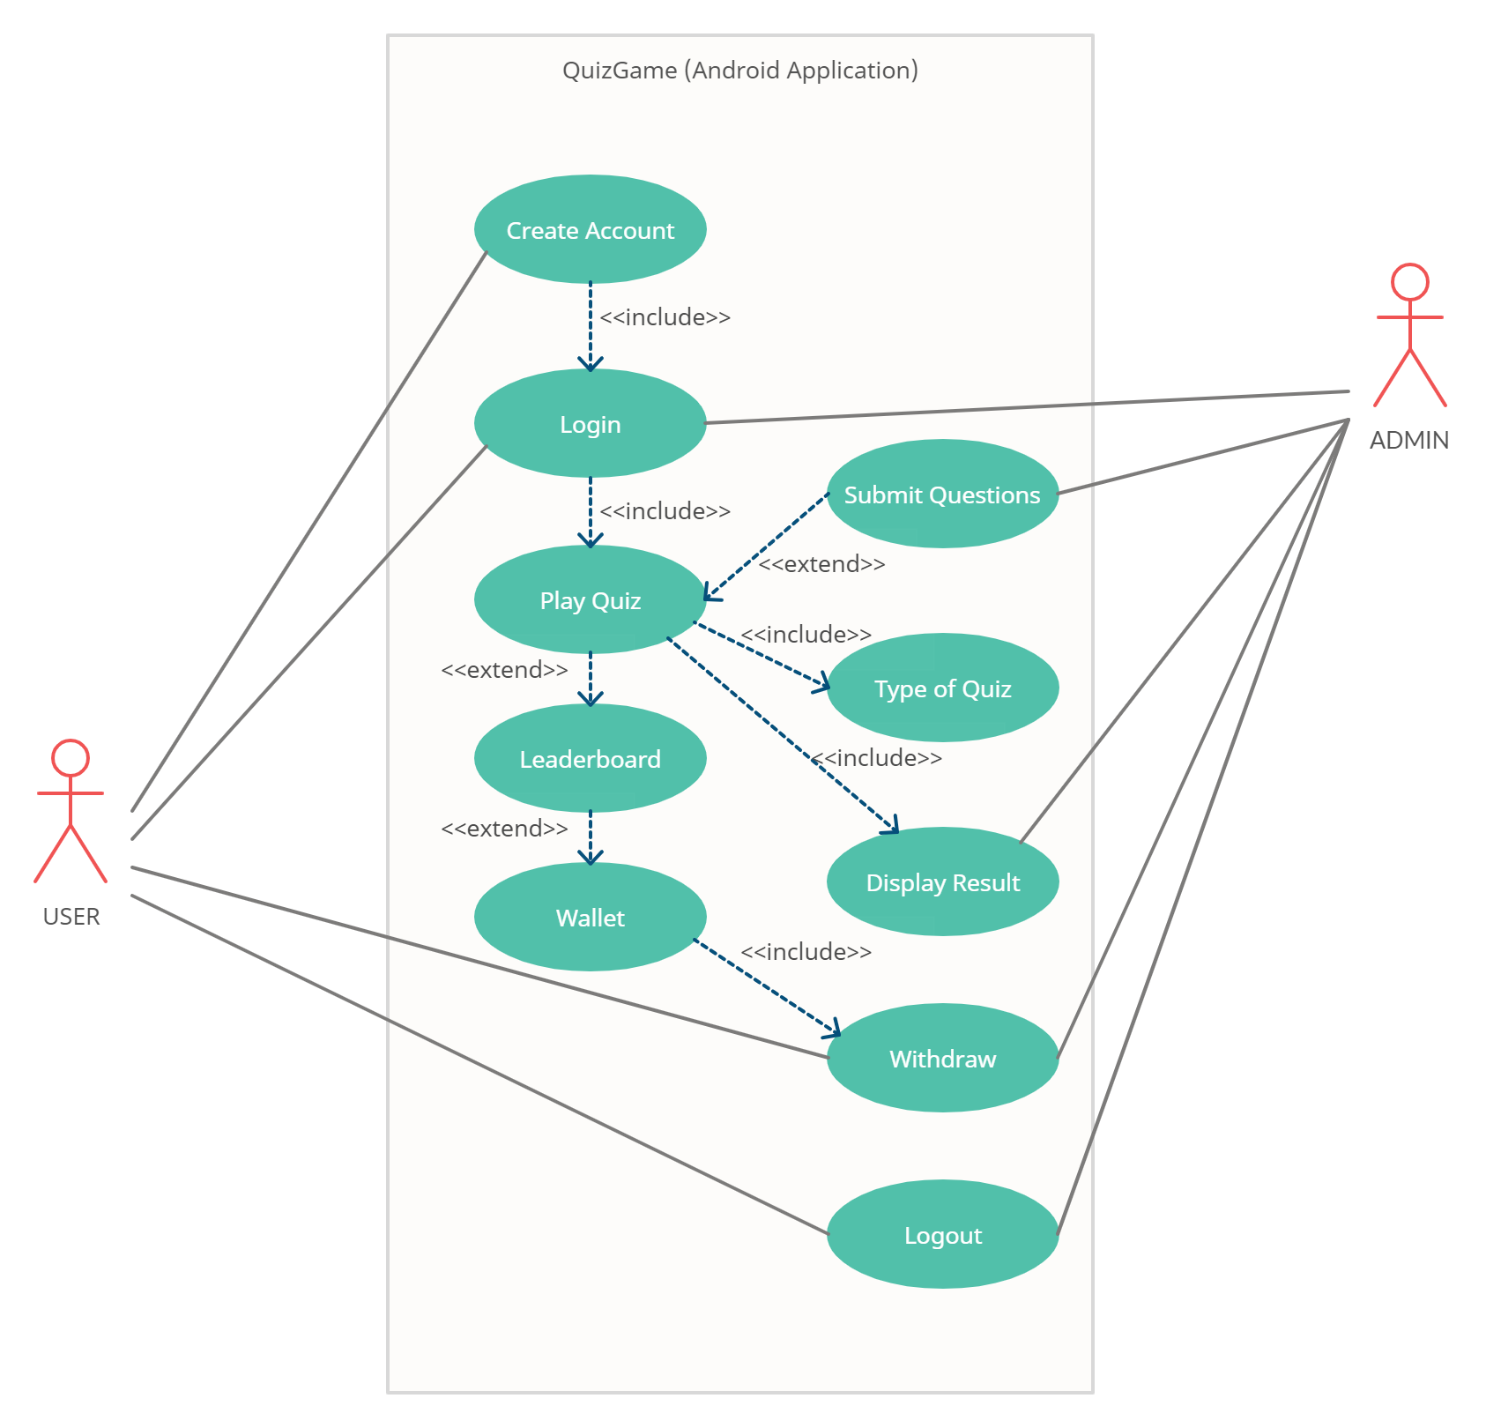
Use case Diagram
MCOE FYMCA-21 QuizGame

Slide 13
Data Dictionary
Account Signup :-
User can create account using email id and password.
Account Login :-
User can login using email id and password.
Categories :-
These are the topics of the quiz.
Quiz Window :-
It displays questions with its options.
Result :-
It is the result of the quiz.
Leaderboard:-
It is rank wise presentation of all the users using the app.
Wallet:-
Contains total coins and withdraw option.
Profile :-
Displays information about current user and a logout option.
MCOE FYMCA-21 QuizGame

Slide 14
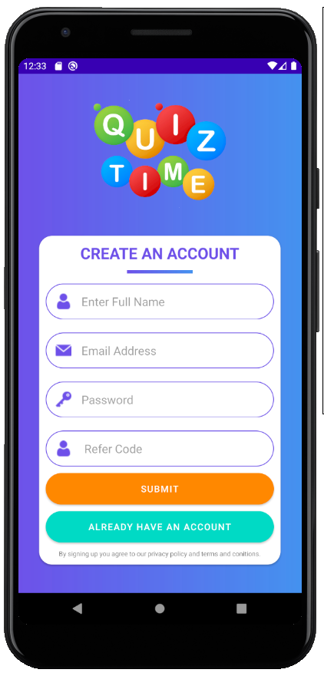
Screen Layouts
Signup Screen:
To create an user account
and sign in to the system.
MCOE FYMCA-21 QuizGame

Slide 15
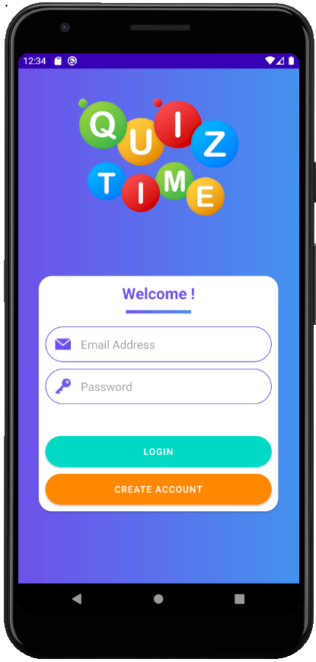
Screen Layouts
Login Screen:
To log in to the system with
existing account.
MCOE FYMCA-21 QuizGame

Slide 16
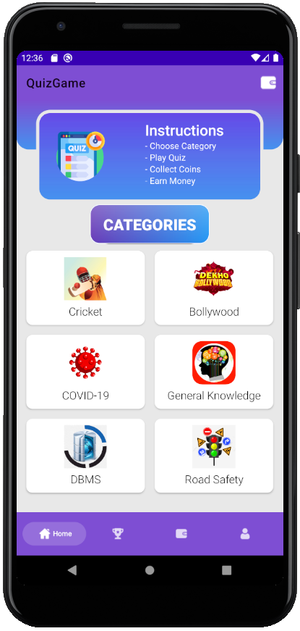
Screen Layouts
Home Screen:
A window which displays
quiz categories and a menu bar
to navigate through the app.
MCOE FYMCA-21 QuizGame

Slide 17
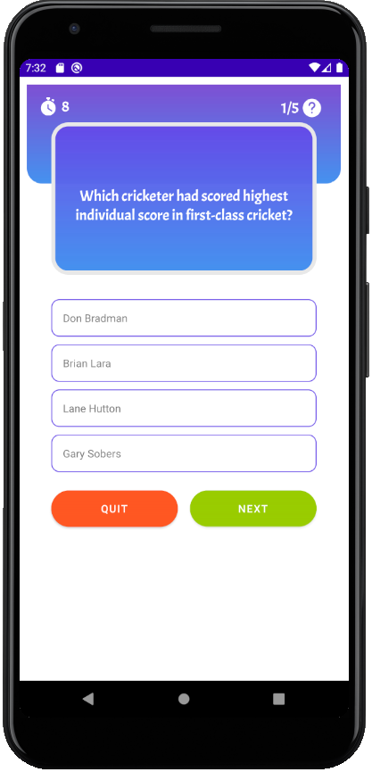
Screen Layouts
Quiz Screen:
Displays questions according
to the chosen category.
MCOE FYMCA-21 QuizGame

Slide 18
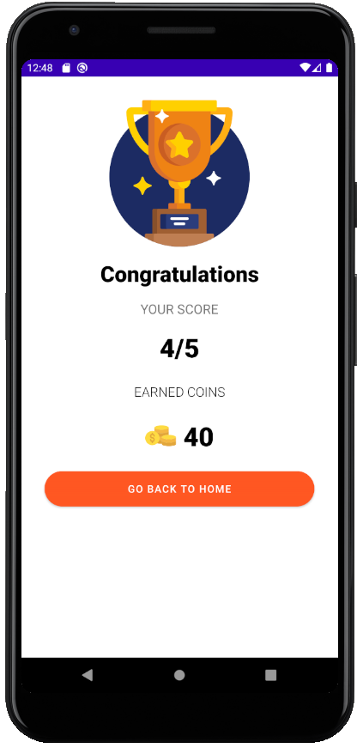
Screen Layouts
Result Screen:
Displays the result of Quiz
and coins earned.
MCOE FYMCA-21 QuizGame

Slide 19
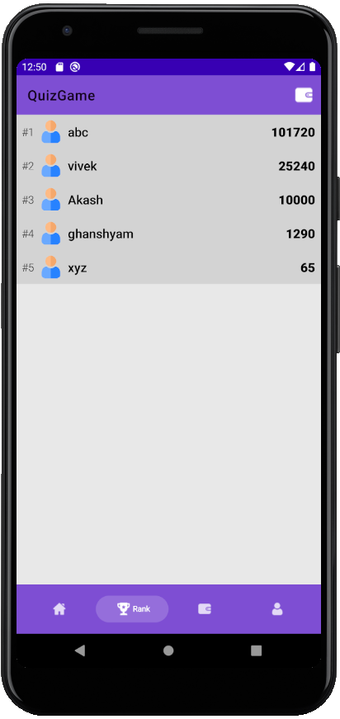
Screen Layouts
Leaderboard Screen:
Displays Leaderboard.
MCOE FYMCA-21 QuizGame

Slide 20
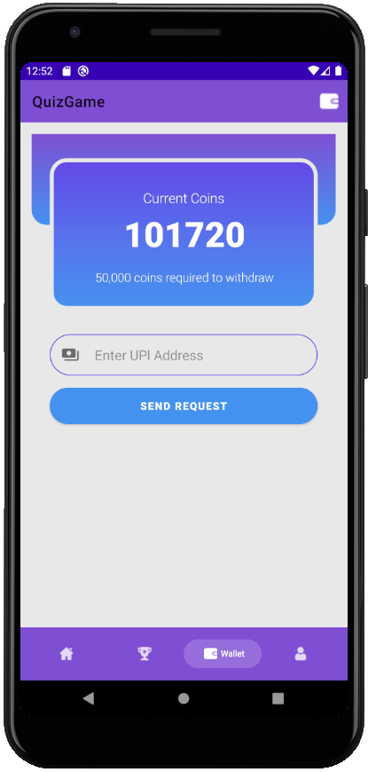
Screen Layouts
Wallet Screen:
Displays total current coins
of the user.
And option to withdraw.
MCOE FYMCA-21 QuizGame

Slide 21
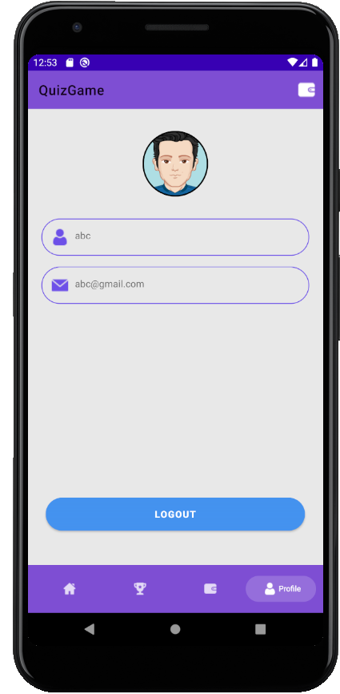
Screen Layouts
Profile Screen:
Displays current user profile
and logout option.
MCOE FYMCA-21 QuizGame

Slide 22
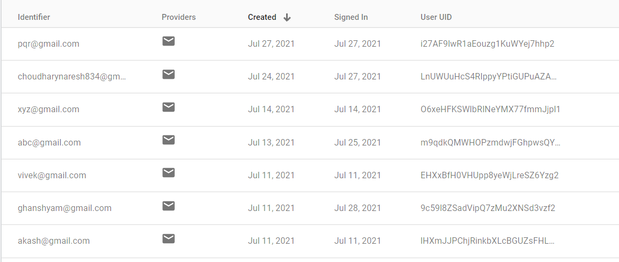
Reports

Slide 23
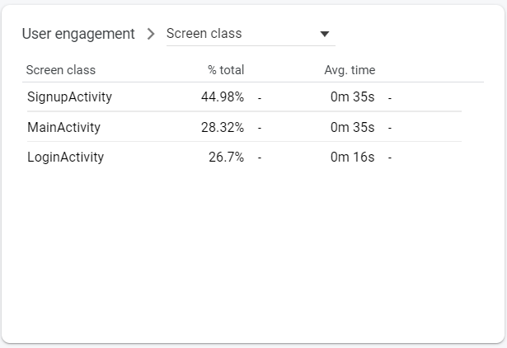
Reports
MCOE FYMCA-21 QuizGame

Slide 24
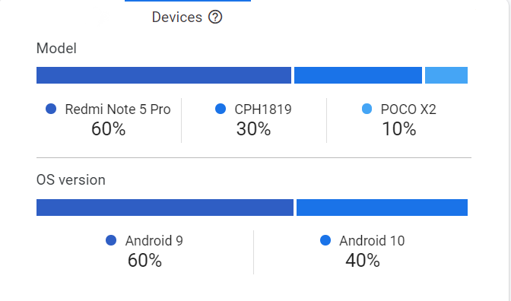
Reports

Slide 25
Limitations & future Enhancements
Limitations of existing system
Quiz Game Requires continuous internet connection. It is major drawback if user has bad or no network connectivity.
Quiz Game only works on android operating system, it is not a cross-platform application.
There is no time limit on how much time user spend on Quiz Game.
Explain how would you eliminate these limitations
Local database(sqlite) can be used to solve internet issues.
User who spend excessive time on app can be restricted for period of time.
MCOE FYMCA-21 QuizGame

Slide 26


